Slide 1
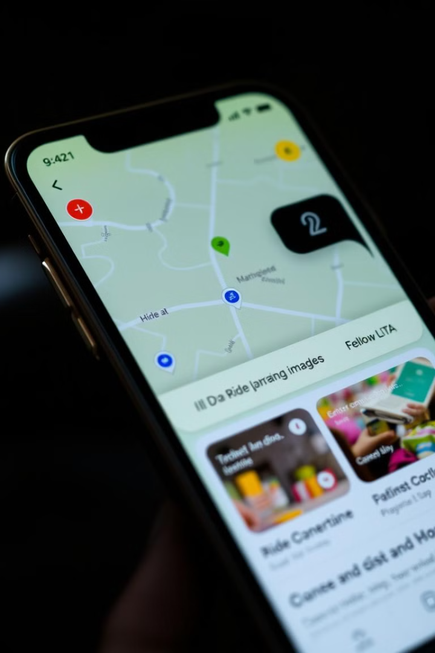

🚖 OLA Data Analyst Project
This presentation explores my OLA Data Analyst project, where I analyzed ride trends using SQL and Power BI. I'll walk you through the process, insights, and recommendations.
by Sahazad Alam Ansiri

Slide 2
Analyzing Ride Trends Using SQL & Power BI
Data Acquisition & Preparation
SQL Queries for Analysis
Power BI Dashboard Design
I wrote SQL queries to extract key insights, such as popular routes, peak hours, and rider demographics.
I gathered ride data from OLA's database and cleaned it for accuracy and consistency.
I used Power BI to create interactive dashboards with visualizations, enabling data exploration and storytelling.

Slide 3

Introduction: Objectives and Agenda
1
Project Overview
2
Data Exploration
This project aimed to analyze OLA's ride data to identify trends and patterns, enabling informed decision-making.
I'll walk you through the process of gathering, preparing, and exploring the data.
3
Data Analysis & Visualizations
4
Key Findings & Business Impact
I'll showcase how I used SQL queries and Power BI dashboards to analyze and visualize the data.
I'll discuss the key findings, their implications for OLA, and potential business benefits.

Slide 4
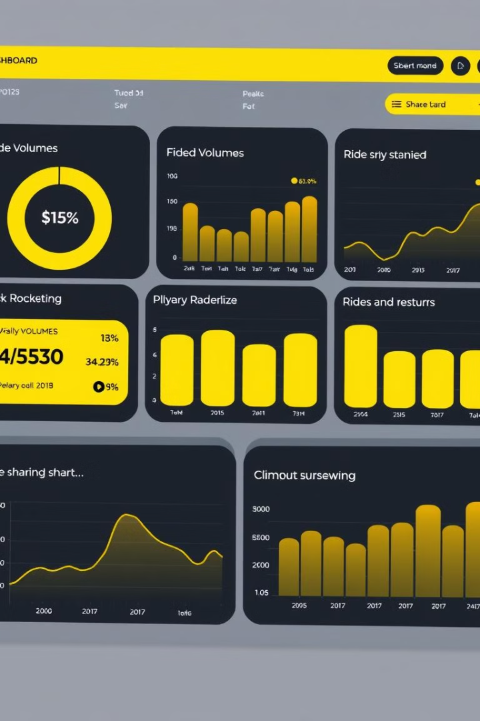
Data Exploration: Gathering and Preparing the Data
Database Access
Data Cleaning & Transformation
I gained access to OLA's ride-sharing database containing detailed information on trips.
I addressed data inconsistencies and missing values, ensuring data integrity and reliability.
Feature Engineering
I engineered new features, such as time of day, day of week, and distance traveled, to enrich the data analysis.

Slide 5




Data Analysis: Uncovering Insights with SQL Queries
Popular Routes
Peak Hours
I identified the most frequently traveled routes by analyzing trip origins and destinations.
I analyzed ride volumes across different time periods to identify peak demand hours.
Rider Demographics
I explored rider characteristics, such as age, gender, and location, to understand customer segments.

Slide 6
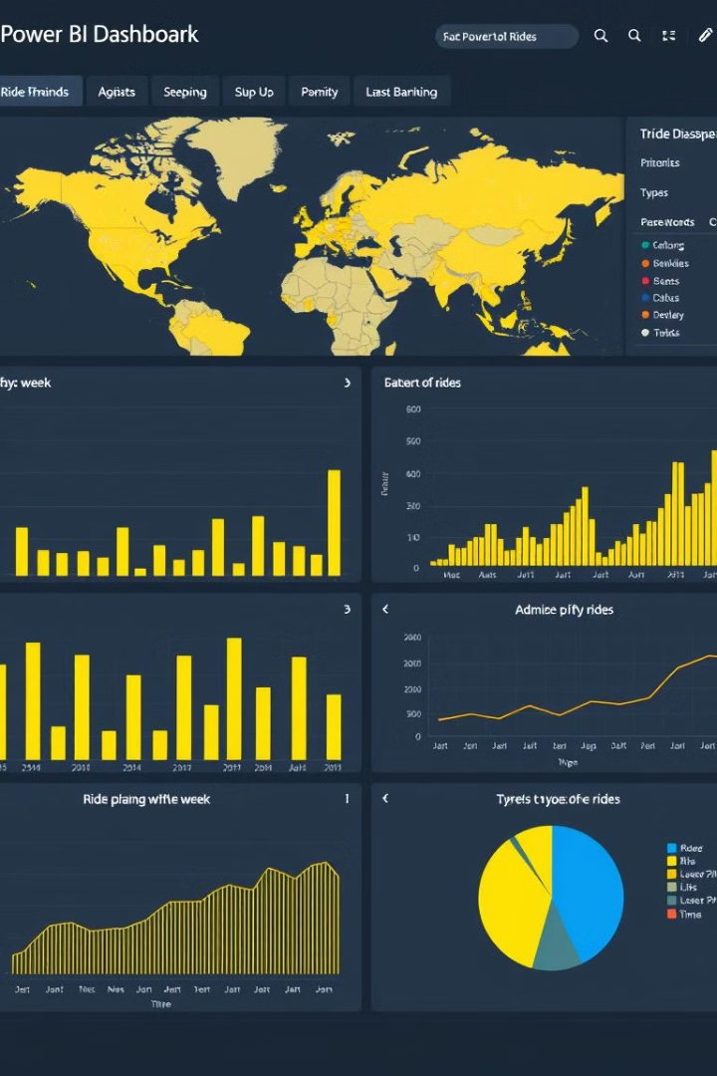
Visualizations: Designing Impactful Power BI Dashboards
1
Interactive Charts
I used charts and graphs to visualize key metrics like ride volume, average trip time, and rider satisfaction.
2
Geographic Maps
I incorporated maps to show the distribution of rides across different locations and regions.
3
Data Filters & Slicers
I added filters and slicers to enable interactive exploration of the data and customized insights.

Slide 7
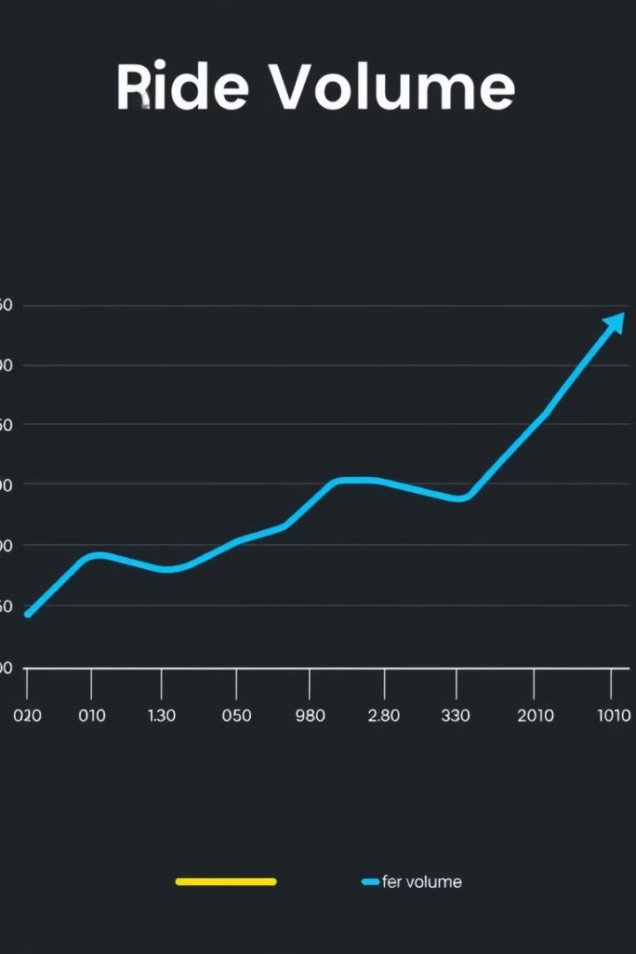



Key Findings: Identifying Trends and Patterns
Ride Volume Growth
My analysis revealed a significant increase in ride volume, indicating OLA's growing popularity.
Peak Hours Variations
I identified distinct peak hours for different days of the week, highlighting variations in demand patterns.
Demographic Insights
The data indicated a preference for ride-sharing among younger demographics and urban dwellers.

Slide 8



Business Impact: Interpreting Results for Decision Making
Optimized Pricing Strategy
1
Data insights can inform pricing adjustments based on demand variations and customer segmentation.
Targeted Marketing Campaigns
2
Demographics insights can guide targeted marketing campaigns to attract specific customer segments.
Fleet Management
3
Data analysis can help optimize fleet size and distribution to meet fluctuating demand patterns.

Slide 9
Challenges and Limitations: Addressing Data Complexities
Data Accuracy & Completeness
1
Addressing inconsistencies and missing values in the data was crucial for accurate analysis.
Data Security & Privacy
2
Ensuring data confidentiality and complying with privacy regulations was a priority during analysis.
Data Volume & Complexity
3
Managing large datasets and handling complex data structures posed challenges for analysis.

Slide 10

Future Recommendations: Enhancements and Next Steps
1
2
3
Real-Time Data Analysis
Predictive Modeling
Customer Segmentation & Personalization
Integrating real-time data analysis to support dynamic pricing and operational decisions.
Developing predictive models to forecast ride demand and optimize resource allocation.
Leveraging data insights to create personalized experiences and tailored marketing campaigns.

Slide 11
Thank YOU
🔗 GitHub: sahazadalam 🔗 LinkedIn: Sahazad Alam Ansiri

